Slide 1


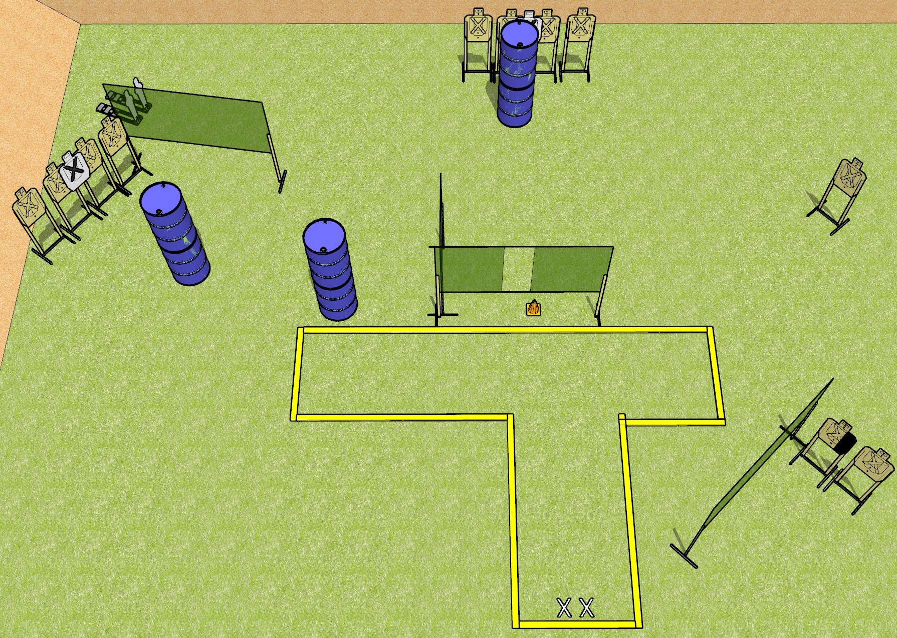
 | Dothan Gun Club – USPSA Match Dot the I Course Designer : Drew Coleman
START POSITION : Standing with both feet on X’s, facing uprange, wrists above respective shoulders.
GUN READY CONDITION : Pistol loaded and holstered. PCC safety on, buttstock on belt, pointed at orange cone |  | SCORING: Comstock, 24 rounds TARGETS: 11 paper, 2 Steel SCORED HITS: Best 2 on paper, steel until down START-STOP: Audible, last shot RULES:
STAGE PROCEDURE: Engage targets as they become available from within the fault lines

